Slide 1
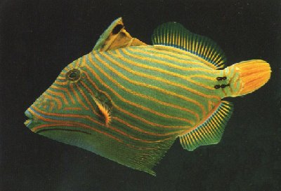
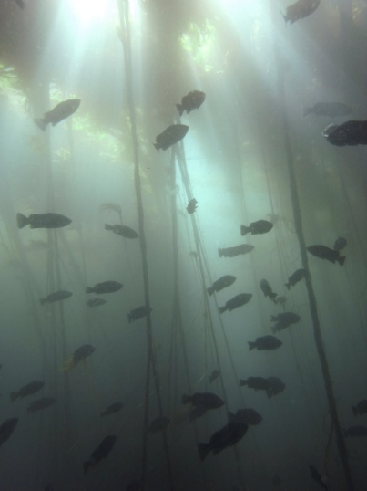
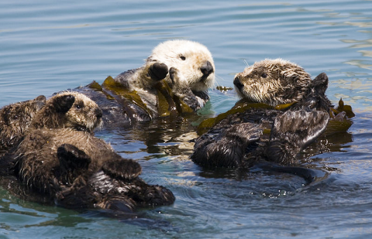
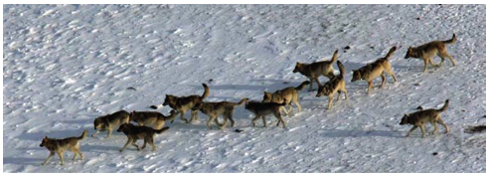
Keystone species and trophic cascades
BISC 830 Fall 2021
Nicholas Dulvy
dulvy@sfu.ca

Slide 3
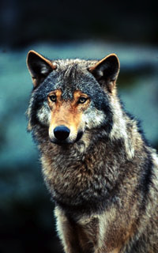
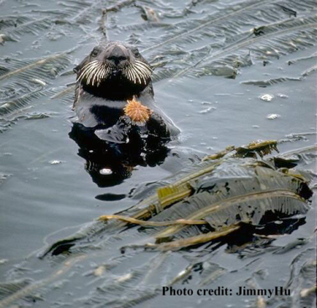
Roadmap for today
Why is the world green? HSS hypothesis
What is a keystone species?
What is a trophic cascade?
Allee effects and resource consumer dynamics
Predatory fishes, starfish and coral reefs
Case studies of mesopredator release/ TC:
Simple keystone cascades (Wolves/cougars, elk, aspen/cottonwood and rivers)
Behaviourally-mediated indirect effects (Fear and loathing in Shark Bay)
www.panda.org
Notes:
Case studies – 2 marine and 2 terrestrial. All except the last include both keystones and cascades
Last one is a good eg of a cascade with no keystone
These case studies will intertwine keystones and cascades – as we’ll learn, the two concepts are inter-linked

Slide 4
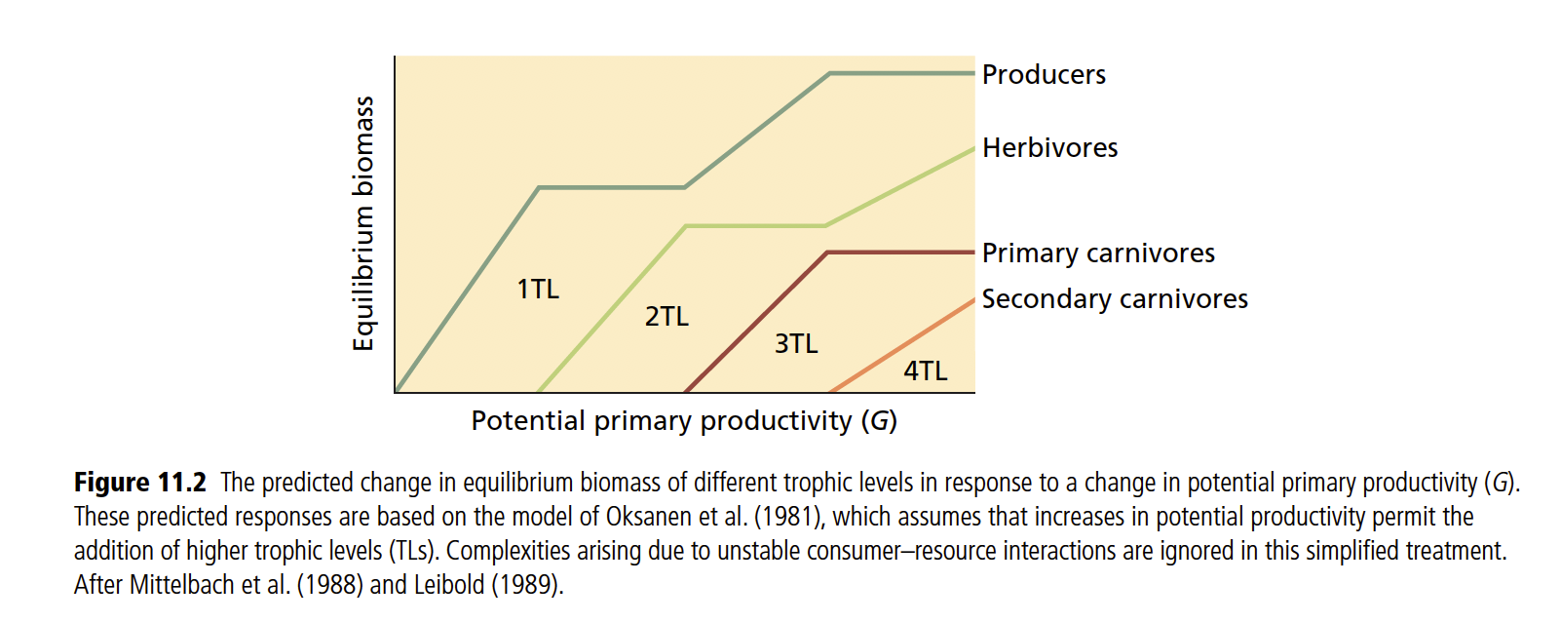
Bottom-up vs. Top-Down processes
Bottom up: Nutrient supply and primary production determine ecosystem structure.
Top down: Higher trophic levels control the abundance of those trophic levels below them, and /or overall ecosystem structure.
Trophic cascades are top-down processes.
Adding nutrients enables more complex food webs

Slide 5
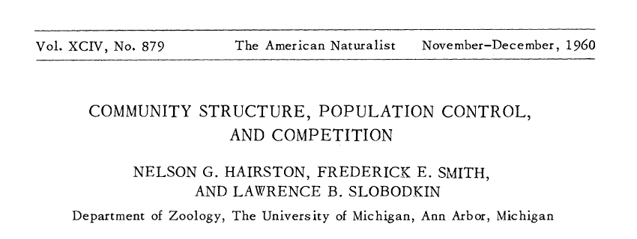
Greenworld conjecture Hairston, Smith & Slobodkin (HSS)

Slide 6
The world is green

Slide 7
Three main findings lead to the conclusion that carnivores suppress herbivores benefiting plants
Carnivores should be limited by competition for their food (herbivores), in the absence of higher–level predation
Consequently, herbivores should be held below their carrying capacity by carnivores and have little impact on their food (plants),
In the absence of control by herbivores, plants should be dense and limited by competition

Slide 8
Despite the logic this is only now widely accepted
Objections:
The world is green because most is inedible due to chemical defenses (Erhlich & Raven 1964)
“Community cascades… are absent to rare in terrestrial habitats”…, because foodwebs have reticulate heterogeneous structure an that many prey, plants in particular are inedible Polis et al. (2000)
“Top-down regulation is a curiosity or aberration, present in some circumstances but not in others, and overall in the big picture, unimportant” (Terbourgh & Estes 2010)
Basically, due to wide-ranging nature of large-bodied predators, “experiments of the scale required have been beyond the capacity and means of scientific establishment” (Terbourgh & Estes 2010)

Slide 9
Top-down (herbivore) and bottom-up (nutrient) control equally likely

Slide 10
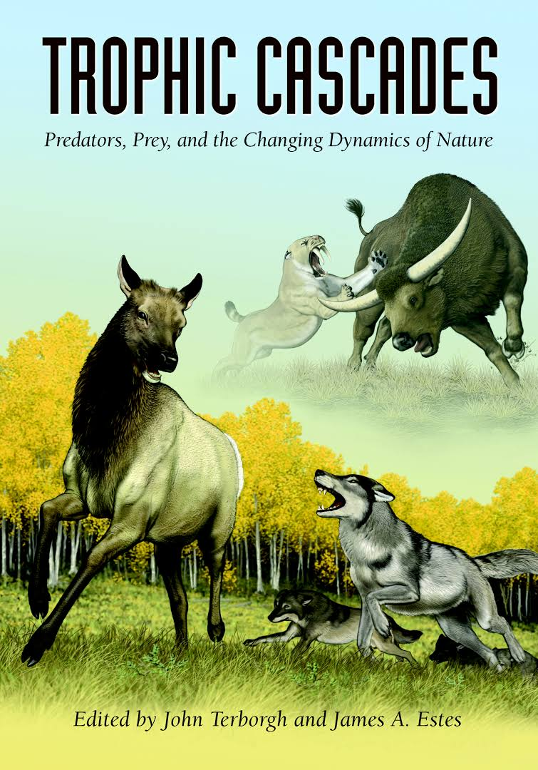
Notes:
2010 publication date

Slide 11
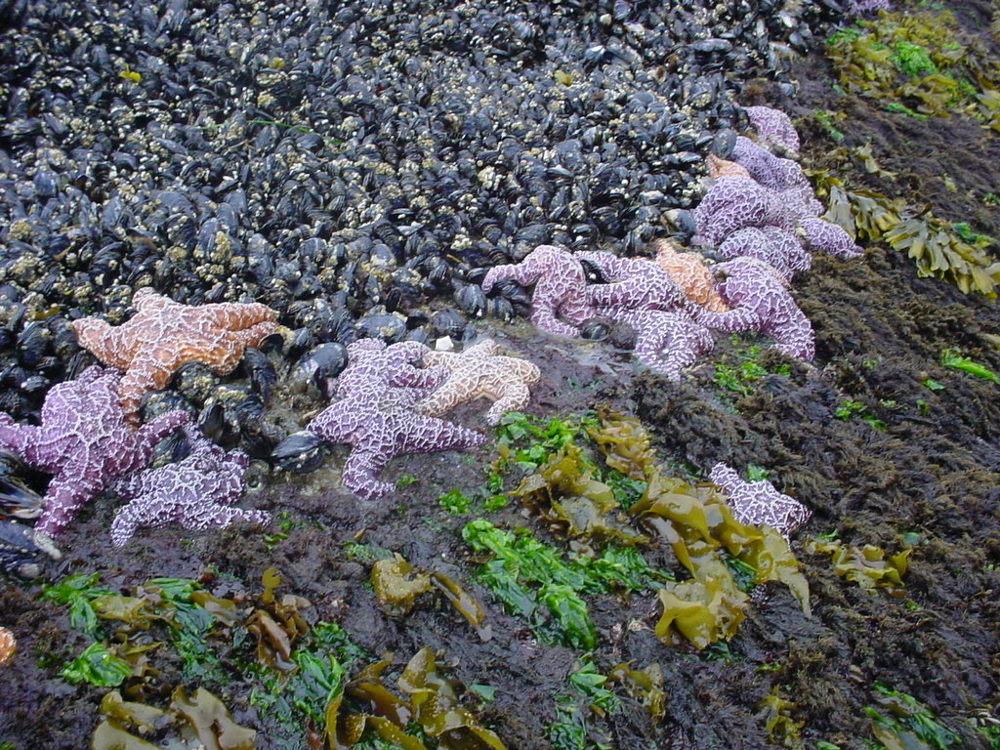
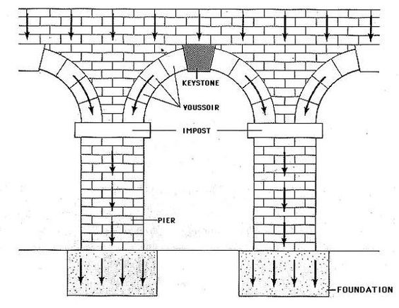
What is a keystone species?
“A species that has a disproportionate effect on its environment relative to its biomass”
Coined by Bob Paine (1969): Pisaster ochraeaus and Mytilus californianus
globalchange.umich.edu
www.wallawalla.edu
Notes:
Particularly apt description, because if you remove a keystone, the structure of the arch is pretty dramatically changed… and the route to rebuilidng the arch is likely to be more complex then just putting the keystone back.

Slide 12
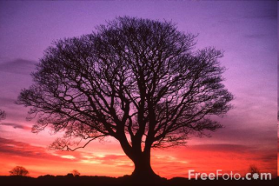
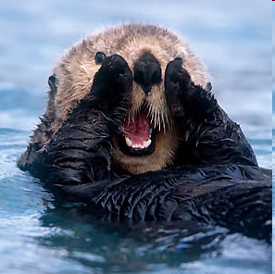
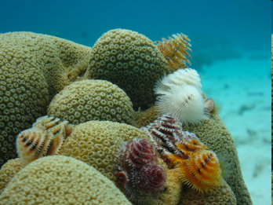
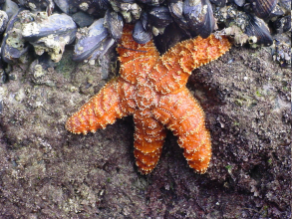
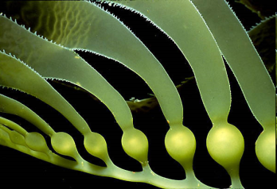
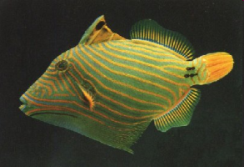
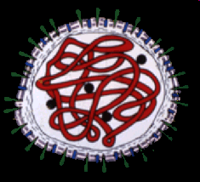
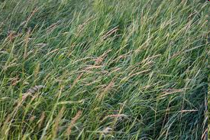
What is a keystone species?
Central idea: a non-abundant species that has a greater-than-expected impact on ecosystem functions via a chain of interactions
Keystone species
Dominant/
Foundation species
Impact on ecosystem
Rare species
Common species
Proportional biomass of species
Power ME, Tilman D, Estes JA, Menge BA, Bond WJ, Mills LS, et al. Challenges in the quest for keystones. Bioscience. 1996;46(8):609-20.
Notes:
Figure adapted from power that’s also in your text book. Useful way to think about it. Emphasise that it’s PER CAPITA influence, not just being an important species. Giant kelps, reef-building corals, forest trees etc all could fit in dominants, but not keystones. Viruses are relatively rare but some can have near keystone effects, such distemper impacts on lions and wild dogs

Slide 13
What a keystone isn’t (necessarily…)
Foundation species
a dominant primary producer in an ecosystem both in terms of abundance and influence
Kelp in kelp forests, coral on coral reefs, trees in a forest…
Umbrella species
Protecting it protects lots of other species too.
Amphibians, tigers, sea horses…
Flagship species
representative ‘poster’ species
Giant pandas, Orangutan, African elephants, manta ray, whale shark…
Indicator species
Indicative of ecosystem ‘health’, biodiversity or other properties of interest

Slide 14
What sort of species are keystones?
Predators
Strong ‘top down’ effects on the structure of communities (Paine 1969)
Sea stars, sea otters , wolves, sharks…
Mutualists
Important nectary plants or pollinator insects
Ecosystem engineers
Bears & maggots – transport salmon nutrients
Beavers – transform river systems and mitigate flooding
Elephants - Mega-herbivores
Brittlestars - bioturbators
Notes:
NOT necessarily apex predators, though sometimes are. Today

Slide 15
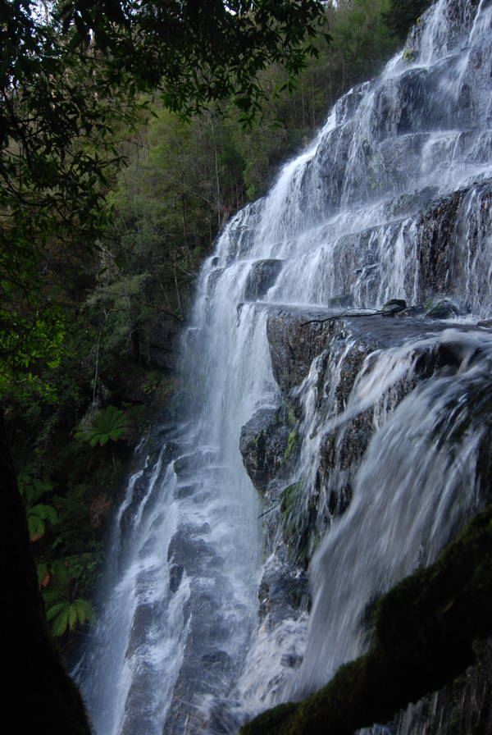
What is a trophic cascade?
Change in abundance that propagates between ≥3 trophic levels
Remember that keystones were non-abundant species with an outsized impact on ecosystem functions through a chain of interactions
Keystones and cascades often associated
Removing a keystone usually leads to a trophic cascade
Notes:
Waterfall is a nice way to think about it – not really a cascade until it tumbles over multiple levels

Slide 16
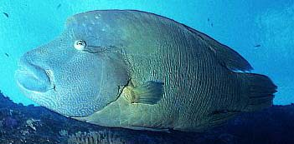
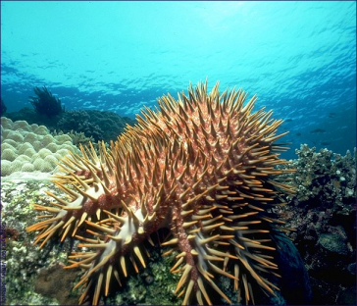
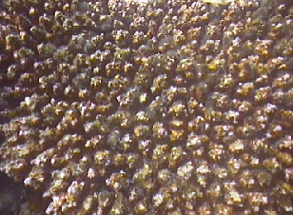
Trophic cascades can short-circuit a food web
Predator(s)
Strong direct
interactions
lead to
strong indirect
link from top to
bottom of food web
-
+
+
prey
-
+
resource

Slide 17
Consumer-resource dynamics, Allee effects, outbreaks and alternate states
N_{t+1} = N_{t}+rN_{t}(1-N_{t}/K) single species logistic growth
Per capita
population growth rate
dn/dt 1/N or N⁻¹
N_{t} Population size
Population growth rate
dn/dt
K
K
K
Time
Population size, N_{t}
Population size, N_{t}
May RM. (1977) Thresholds and breakpoints in ecosystems with a multiplicity of stable states. Nature 269, 471-477.
Knowlton N. (1992) Thresholds and multiple stable states in coral reef dynamics. American Zoologist 32, 674-682.

Slide 18
Population growth - predation rate
logistic population growth
logistic population growth
and predation
Alpha – attack rate
Beta – prey saturation

Slide 19
Population growth + predation rate
Predation rate <
prey growth rate
Predation rate >
prey growth rate
Intermediate
predation
Prey population
growth rate
(dn/dt)
Type 2
predation
Prey population size
Prey largely unaffected
Prey eliminated
Alternate
States
Lower prey carrying capacity
or extinction
May RM. Thresholds and breakpoints in ecosystems with a multiplicity of stable states.
Nature. 1977; 269:471-7.

Slide 20
Allee effects and outbreak dynamics emerge from simple predator-prey models
Prey per capita population
growth rate (dn/dt)
0
Population size
Small prey populations < unstable equilibrium,
spiral to local extinction
Large prey populations exceed the unstable equilibrium point
resulting in outbreaks

Slide 21
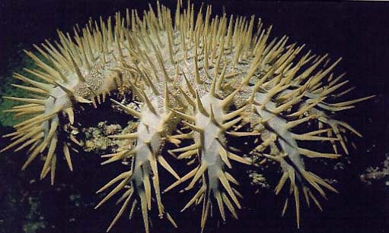
Starfish outbreaks modulated by Allee effect
3
2
Starfish
Per capita growth rate
1
0
-1
10²
10³
10⁴
10⁵
Starfish density (#/km²)
Dulvy, Freckleton & Polunin (2004) Ecology Letters 7:4210-416

Slide 22
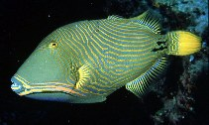
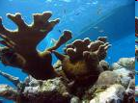
Fishing induced trophic cascade
15
10
Predator biomass
(g m²)
5
0
10
100
Fishing intensity (persons·km reef⁻¹)
6
4
Starfish
(log₁₀# km⁻²)
2
0
0
20
40
60
Fishing intensity (persons·km reef⁻¹)
100
Calcifying benthos
Benthic cover %
50
Non-calcifying benthos
0
40
20
0
Predator density (g m²)

Slide 23
Cascading effects of loss of top predators
Fisheries-Induced Trophic Cascades (FITCs):
Humans > predators > meso predators > lower trophic level effects
Mesopredator release (more complicated TL) racoons
Loss of top predators > increase of mesopredators > decline of mesopredator prey >??
Trophic cascades (3 TL) Wolves, Tiger shark
Loss of top predators > increase in herbivores > decline of plant populations
Touching on Direct and indirect behaviourally mediated effects.

Slide 24
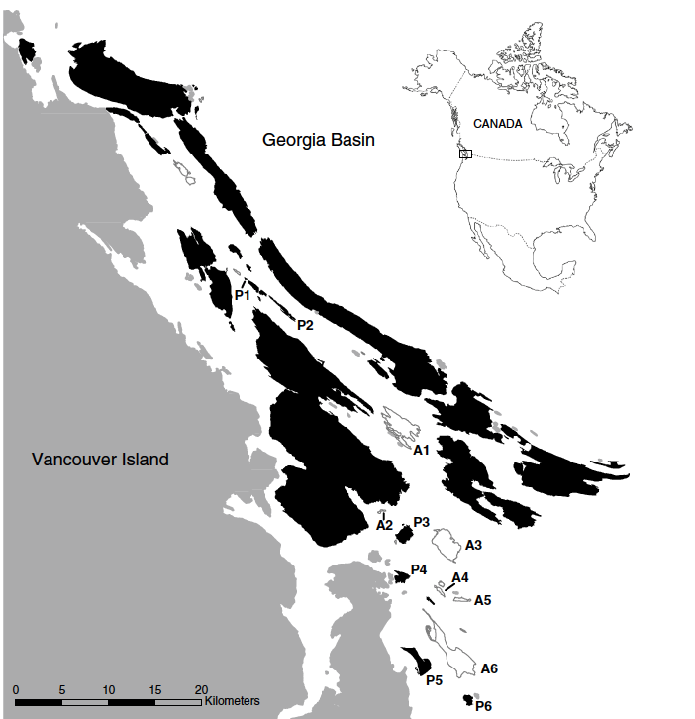
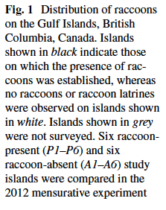
Local consequences of the rise of mesopredators
Absence of cougar, wolves, black bear enabled establishment of racoons
Racoon present
(black)
Racoon free
(white)

Slide 25
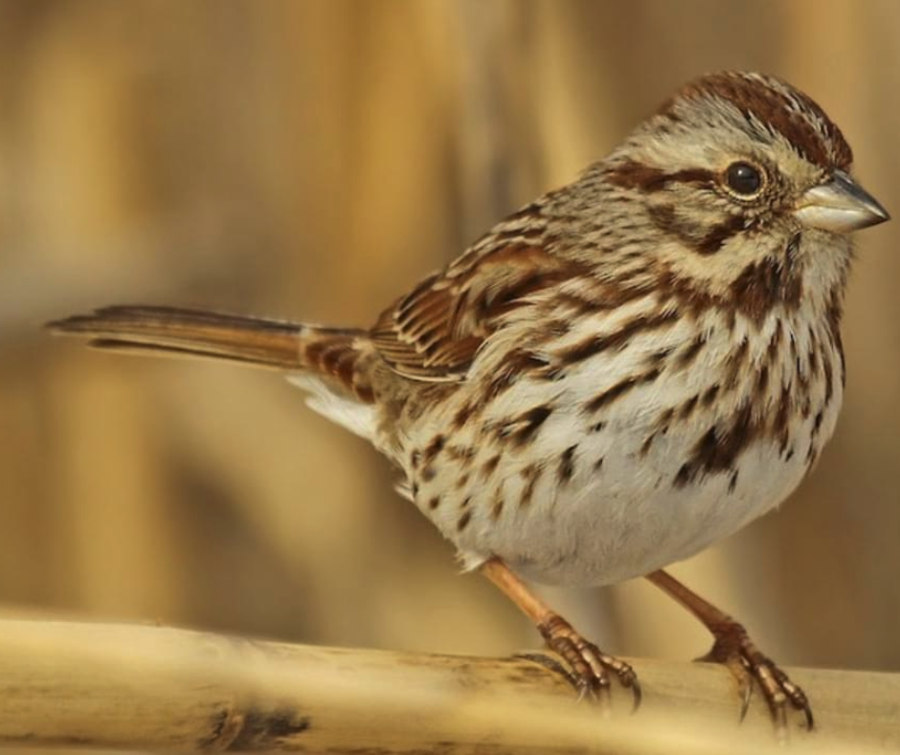
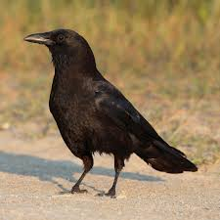
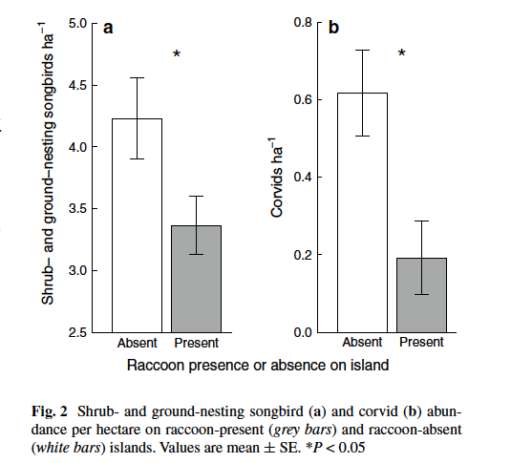
More birds without racoons…
Suraci JP, Clinchy M, Zanette LY, Currie CMA and Dill LM. (2014) Mammalian mesopredators on islands directly impact both terrestrial and marine communities. Oecologia 176, 1087-1100.

Slide 26
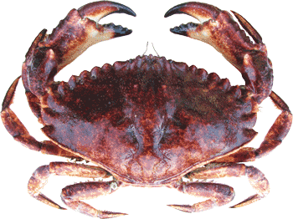
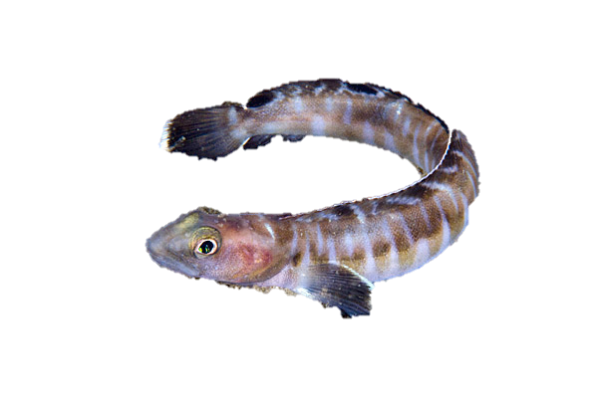
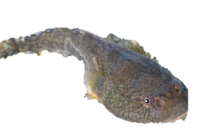
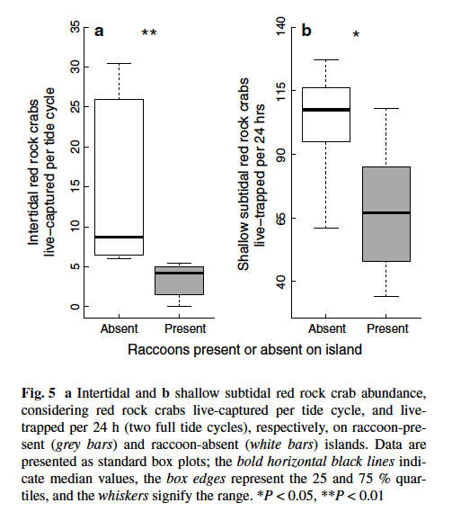
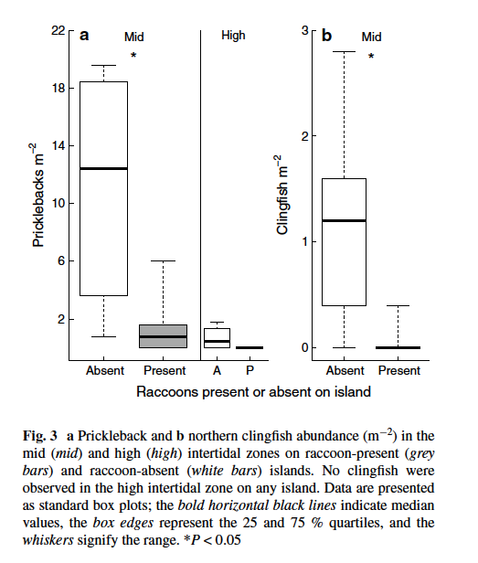
…and sea

Slide 27
1. (Mainly) direct consumptive effect cascades - Wolf recovery

Slide 28
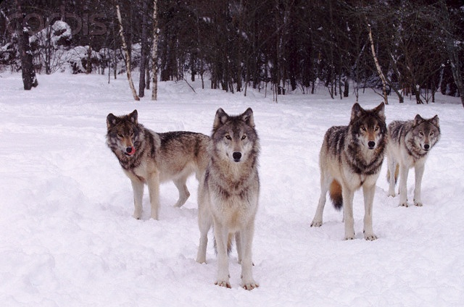
Historical and recent gray wolf population trends in the conterminous 48 United States
Ripple & Beschta 2005 Bioscience

Slide 29
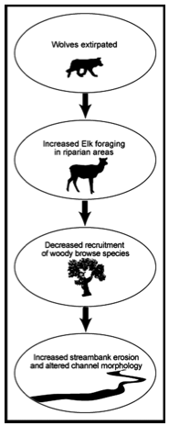
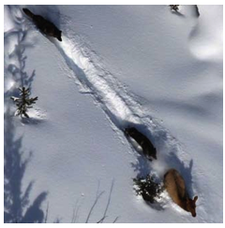
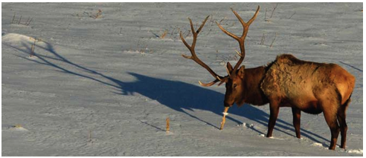
Natural experiment: Wolves
The Yellowstone Wolf Project Report 2008
Beschta and Ripple 2008

Slide 30
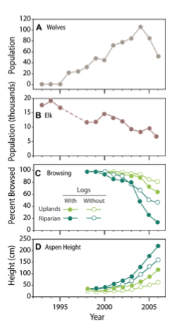
Large-scale natural experiment: Wolves in Yellowstone
Wolves extirpated in early 1900s
Re-introduced to Yellowstone in 1995-1996
Presence of wolves leads to broad changes in elk grouping, foraging behavior, habitat selection, diet, and nutrition (Creel and Christianson 2009)
Reduction in aspen grazing, esp. in dangerous scary riparian areas.
Combined density (predation) and behavioural effect
Elk less likely to graze in areas with poor escape routes or visibility with wolves around streams.
dangerous
Ripple and Beschta 2007

Slide 31
Uplands vs. Riparian
} Lesser fraction of riparian browsed…
} …hence taller trees
Ripple and Beschta 2007

Slide 32
Fallen log effects
less browsing with logs present…
hidey-holes for wolves
…resulting in taller trees along rivers
(harder to spot wolves, fewer escape routes)
Ripple and Beschta 2007

Slide 33
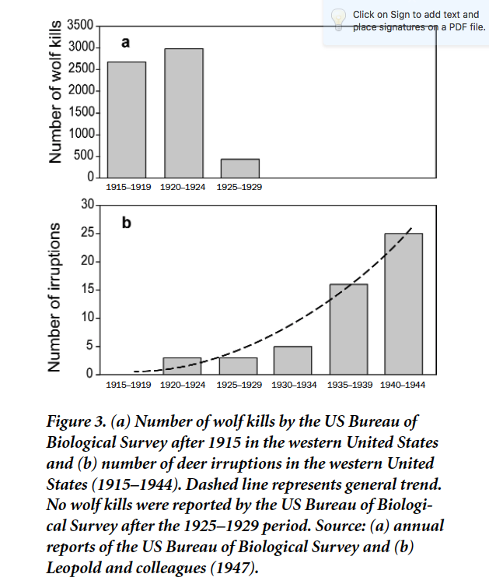
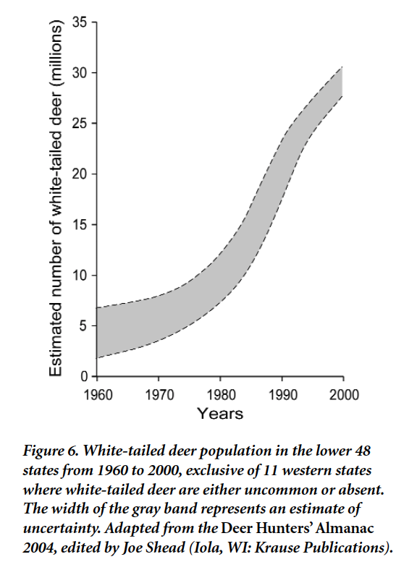
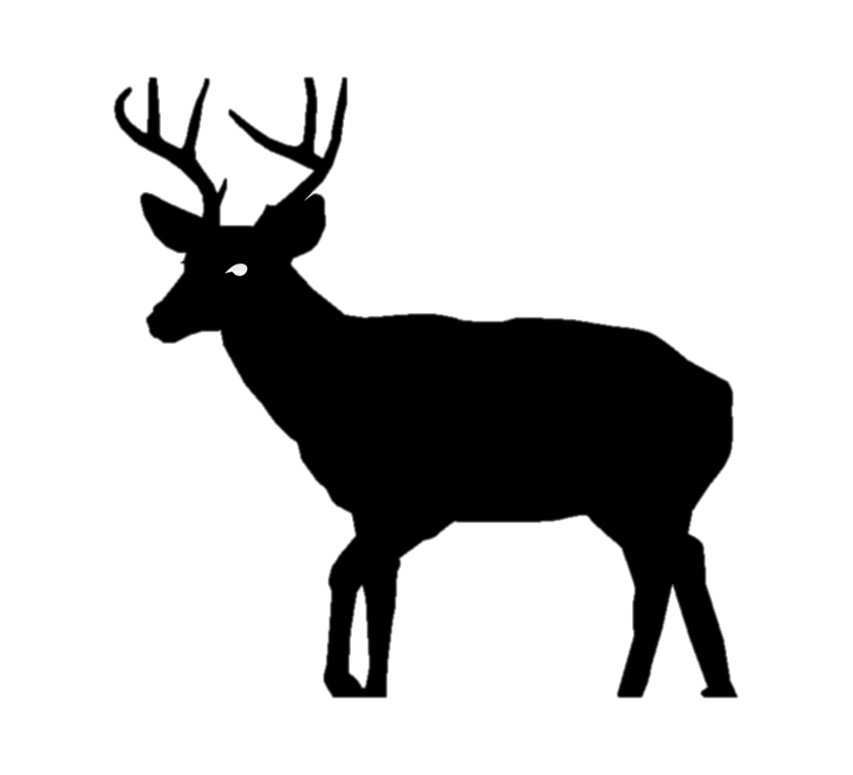
Not just elk, white-tailed deer too!
Ripple and Beschta 2005 Bioscience

Slide 34
Case Study: Wolves in Yellowstone
Aspen hindcast age structure from 1840 to 2000, most trees old, few new saplings.
An aspen stand showing heavy bark damage from elk along the lower several meters of each tree and a long-term lack of recruitment (tall saplings and small diameter trees are missing)
Ongoing aspen recruitment within a fenced elk exclosure and an absence of recruitment outside the fence.
Beschta & Ripple 2009 Biol. Con.
Notes:
Fig. 1. (a) Aspen age structure from 1840 to 2000, (b) an aspen stand showing
heavy bark damage from elk along the lower several meters of each tree and a longterm
lack of recruitment (tall saplings and small diameter trees are missing), and (c)
ongoing aspen recruitment within a fenced elk exclosure and an absence of
recruitment outside the fence (even though root sprouts are present); all in the
northern range of Yellowstone National Park. For the period following the
extirpation of wolves in Yellowstone, significant decreases (95% lower CI) in aspen
tree frequencies are indicated by ‘‘”. Source: adapted from (a) Larsen and Ripple
(2003).

Slide 35
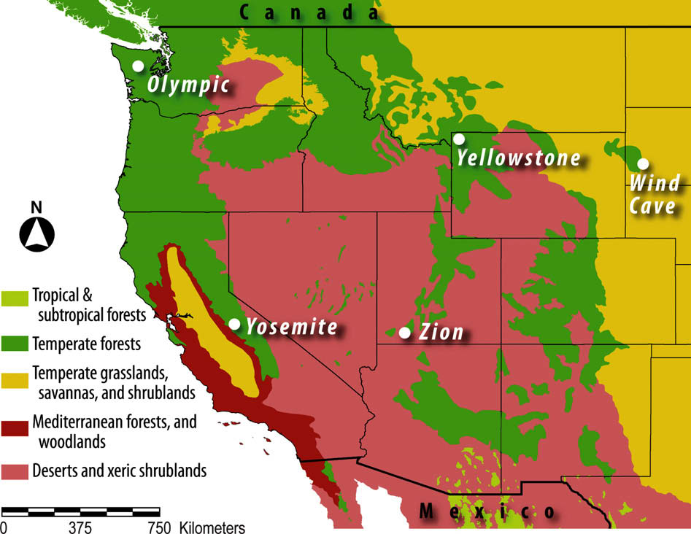
Predator-deer-tree cascade in temperate forests
Beschta & Ripple 2009

Slide 36
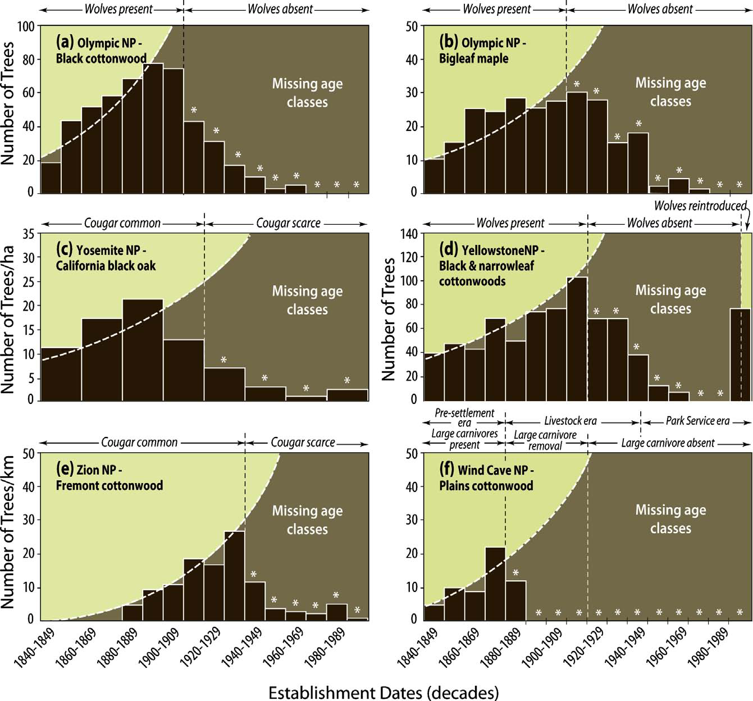
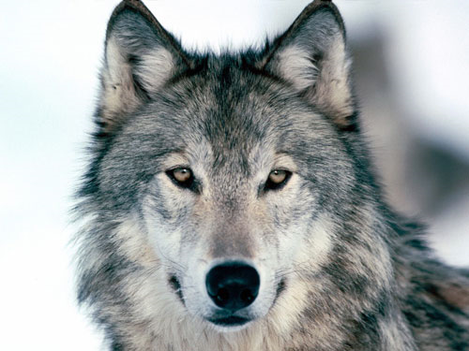
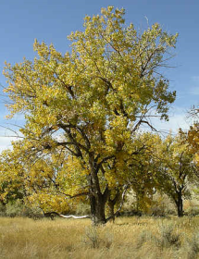
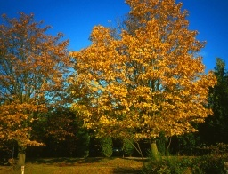
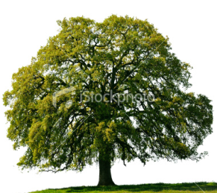
Beschta & Ripple 2009

Slide 37
“A severe decrease in recruitment of woody species following loss of predators”
Beschta & Ripple 2009 Biol. Cons.

Slide 38
Following a 70-year
period of wolf extirpation, heavy browsing of willows and conifers is evident in the 1996 photograph.
In 2002, after 7 years of wolf recovery, willows show evidence of release from browsing pressure

Slide 39
Half
width
wide

Slide 40
Trophic interactions due to predation risk and selected ecosystem responses in N Yellowstone

Slide 41
2. Indirect behaviourally-mediated mesopredator effect / cascades

Slide 43
Direct consumptive versus indirect “ecology of fear” effects

Slide 44
Burkholder, D. A., Heithaus, M. R., Fourqurean, J. W., Wirsing, A. and Dill, L. M. (2013) Patterns of top-down control in a seagrass ecosystem: could a roving apex predator induce a behaviour-mediated trophic cascade? Journal Of Animal Ecology, DOI: 10.1111/1365-2656.12097

Slide 45
Natural experiment: compare behaviour in summer (sharks+) vs. winter (no shark)
Winter
(no/few sharks)
Summer
(lots of sharks)
<2.5 m deep,
>75m from
deeper channels >4.5m

Slide 46
control
cage
Day 1
Day
600

Slide 49
Wider Implications
Human exploitation, especially removal of keystone species may trigger mesopredator release and change in lower TL including in primary producers (trophic cascades)
Increasing acceptance that top-down effects are hard to observe but to be expected whenever entire functional groups of predators are depressed, a la HSS ‘why is the world green’.
Often lead to altered ecosystem states, which can be long-lasting and difficult to reverse
“The take-home message is clear: the presence of a viable carnivore guild is fundamental to maintaining biodiversity” (Terborgh. et al 2006)
Trophic cascades alter ecosystems, as well as the social and economic systems that depend on them

Slide 50
Varying strength of inference
Lab experimental evidence is excellent
Natural experiments at larger scales compelling
Recovery of wolves
Shark Bay - seagrass
Predator-free islands - Terbourgh
Fishing pressure gradients
Time-series alone unsuitable for detecting effects in coastal-ocean systems
‘Reticulate’ effects apparent in tropical ecosystems
Diversity: High species diversity and foodweb complexity can reduce the trophic impact of predators and prevent strong cascading effects.
Effects are context-dependent
Productivity (amount/type)
Consumer efficiency
Ford AT and Goheen JR. (2015) Trophic Cascades by Large Carnivores: A Case for Strong Inference and Mechanism. Trends in Ecology and Evolution 30, 725-735.

Slide 51
Suggested reading
Beschta, R. L., and W. J. Ripple. 2005. Linking Wolves and Plants: Aldo Leopold on Trophic Cascades. Bioscience 55:613-621.
Beschta, R. L., and W. J. Ripple. 2009. Large predators and trophic cascades in terrestrial ecosystems of the western United States. Biological Conservation 142:2401-2414.
Burkholder, D. A., Heithaus, M. R., Fourqurean, J. W., Wirsing, A. and Dill, L. M. (2013) Patterns of top-down control in a seagrass ecosystem: could a roving apex predator induce a behaviour-mediated trophic cascade? Journal of Animal Ecology, DOI: 10.1111/1365-2656.12097.
Dulvy, N. K., R. P. Freckleton, and N. V. C. Polunin. 2004. Coral reef cascades and the indirect effects of predator removal by exploitation. Ecology Letters 7:410-416.
Estes et al. (1998) Killer Whale Predation on Sea Otters, Linking Oceanic and Nearshore Ecosystems. Science, 282, 473-476
Knowlton N. 1992. Thresholds and multiple stable states in coral reef dynamics. American Zoologist 32: 674-682.
May RM (1977) Thresholds and breakpoints in ecosystems with a multiplicity of stable states. Nature 269:471-477
L. Scott Mills et al. (1993) The Keystone-Species Concept in Ecology and Conservation. BioScience, 43 (4), 219 (1993).
Polis GA, Sears ALW, Huxel GR, Strong DR, & Maron J (When is a trophic cascade a trophic cascade? Trends in Ecology & Evolution 15(11):473-475.
Power, M. E., D. Tilman, J. A. Estes, B. A. Menge, W. J. Bond, L. S. Mills, G. Daily, J. C. Castilla, J. Lubchenco, and R. T. Paine. 1996. Challenges in the quest for keystones. Bioscience 46:609-620.
Prugh, L. R., C. J. Stoner, C. W. Epps, W. T. Bean, W. J. Ripple, A. S. Laliberte, and J. S. Brashares. 2009. The Rise of the Mesopredator. Bioscience 59:779-791.
Ripple, W. J., and R. L. Beschta. 2006. Linking a cougar decline, trophic cascade, and catastrophic regime shift in Zion National Park. Biological Conservation 133:397-408.
Ripple, W. J., T. P. Rooney, and R. L. Beschta. 2010. Large predators, deer and trophic cascades in boreal and temperate ecosystems. Pages 141-161 in J. Terborgh and J. A. Estes, editors. Trophic cascades. Island Press, Washington, DC.
Ripple WJ, Beschta RL. 2007. Restoring Yellowstone's aspen with wolves. Biological Conservation 138: 514-519.
Salomon AK, Gaichas SK, Shears NT, Smith JE, Madin EMP, Gaines SD (2010) Key features and context-dependence of fishery-induced trophic cascades. Conservation Biology 24:382-394
Suraci JP, Clinchy M, Zanette LY, Currie CMA, Dill LM. 2014. Mammalian mesopredators on islands directly impact both terrestrial and marine communities. Oecologia 176: 1087-1100.
Terborgh, J. et al. (2001) Ecological Meltdown in Predator-Free Forest Fragments. Science 294, 1923-1926.
Wootton JT, Power ME. 1993. Productivity, consumers, and the structure of a river food chain. Proceedings of the National Academy of Sciences 90:1384-1387.
Notes:
All of these are nice, short and readable

