Slide 1
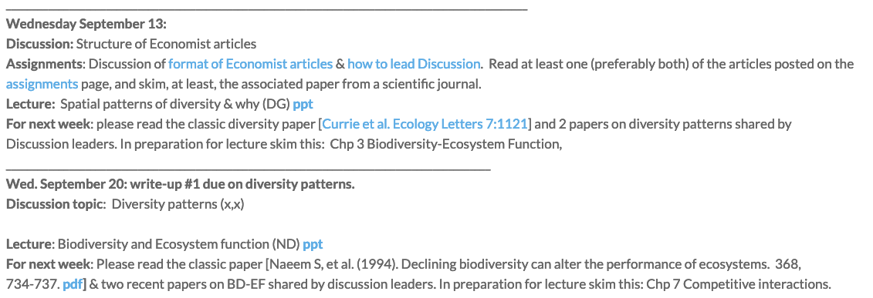
Week 2 plan

Slide 2
Breaking it down
Who is doing the discussion and when
What time can people circulate Discussion papers ‘bisc-830@sfu.ca’
David’s lecture & discussion of book chapter
Why and how to read
How to lead a discussion
Grade breakdown

Slide 3
Lecture | Discussion topics | Week of Discussion
Spatial patterns of diversity | Structure of Economist articles | Sept 13
Biodiversity and Ecosystem function (ND) | Diversity patterns | Sept 20
Interactions 1: niche, resources, competition & coexistence (DG) | BD-EF | Sept 27
Interactions 2: predators, prey, stability, cycles, feedback & coexistence (DG) | Competition | Oct 4
Direct & Indirect interactions, measuring them, trophic cascades (ND) | Predation | Oct 11
Food webs/networks | Trophic cascades | Oct 18
Succession and community assembly (DG) | Food webs/networks | Oct 25
Neutrality (ND) | Succession and community assembly | Nov 01
Trait-based community ecology | Neutrality | Nov 8
How to peer-review | Trait-based community ecology | Nov 15

Slide 4
Discussion leaders | Discussion topics | Week of Discussion
NA | Structure of Economist articles | Sept 13
2x | Diversity patterns | Sept 20
2x | BD-EF | Sept 27
1x | Competition | Oct 4
2x | Predation | Oct 11
1x | Trophic cascades | Oct 18
2x | Food webs/networks | Oct 25
2x | Succession and community assembly | Nov 01
2x | Neutrality | Nov 8
2x | Trait-based community ecology | Nov 15

Slide 5
Why do you read & how do you read
Discuss

Slide 6
How to read
General: the three big questions to keep in mind
What did the author(s) do?
What are the hypotheses?
Why should we care?
Do you believe it?
What assumptions are made?
What is the experimental design, and is it appropriate?
What do the data say? Is the interpretation of the authors appropriate?
What is the significance of the work?
Notes:
Reading for courses and to generally keep up with the literature, vs. reading for your research program

Slide 8
The Big Questions, from Little and Parker
a. What is the mode of research?
b. What questions does the paper address?
c. What are the main conclusions of the paper?
d. What evidence supports those conclusions?
e. Do the data actually support the conclusions?
f. What is the quality of the evidence?
g. Why are the conclusions important?
http://www.biochem.arizona.edu/classes/bioc568/papers.htm

Slide 9
Reading process
Skim -- Read Title, Authors, Abstract and Discussion first (?), read figures and legends (determine relevance)
Reading sequence changes over career/experience
Vocabulary -- look up technical terms, flag new concepts (ie “risk reduction”, “model selection”) for further reading
Comprehension – the rest of the presentation
Reflection and analysis – can you describe the paper to someone else?

Slide 10
What makes a summary effective?
What would change for
a Scientific Audience?

Slide 11
The role of the Discussion Leader
Discussant is not world expert—just responsible for guiding discussion
Discussant circulates (via class email list) a list of 3-5 insightful questions along with the paper by end of Thursday (is that possible)
In class, give short summary (3–5 min AT MOST) of the classic and the pair of papers to orient class, followed by the list of questions; try to engage your classmates rather than filling the time yourself
30 minutes per paper (so, 1–1.5 hrs discussion each week)

Slide 12
3–5 questions
What was the premise and core hypothesis?
What statistical inferential approach did the authors use?
We normally think about sexual selection and individual mating success, what was novel here?
How general is the finding?
What would the next obvious question / study be?

Slide 13
Mark Breakdown
TREE paper, 35%
Your review of two TREE papers written by classmates: 10%
Weekly write-ups, 6% each * 5 = 30%
Discussion:
Participant 10%
Moderator 15%

Slide 14
Next week

